Slide 1
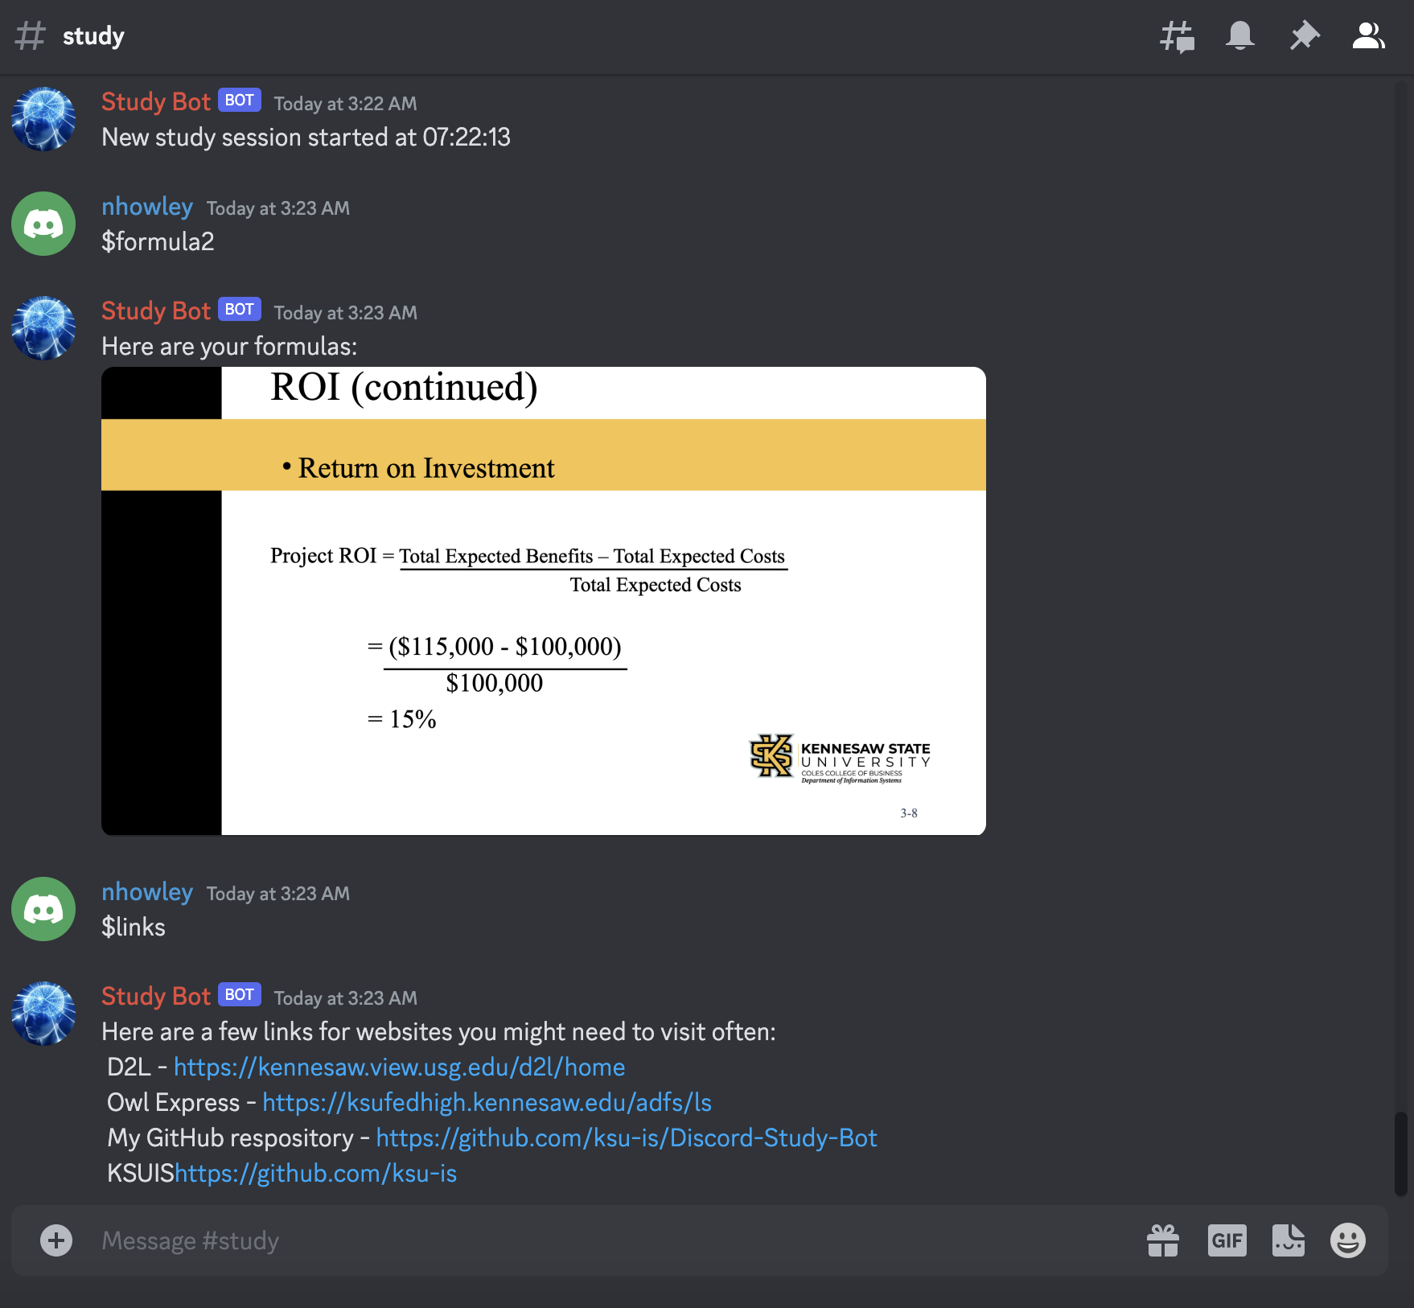
Discord Study Bot
Provides tools to help with studying or whatever you may need!
https://github.com/ksu-is/Discord-Study-Bot/tree/main
Nick Howley

